Slide 1
SD CARD INTERFACE WITH FPGA ON MULTIMEDIA APPLICATIONS
MEMBERS :
Sakthekannan M S (212219060228)
Udaya Krishnan M (212219060284)
Yogavignes BM (212219060302)
GUIDE:
Dr. Srigitha S Nath

Slide 2
ABSTRACT
Based on FPGA (Field Programming Gate Array) chips, this application is used for audio and image processing.
At the same time, applications require more memory in addition to on-chip memory to resolve additional data. Onboard memory can be used to meet the requirements of FPGA systems but cannot be expanded by adding just a few cards.
More convenient is SD card (Secure Digitals) which can read and write to SD card.
FPGA (Spartan 6) runs on 5V power supply with a built-in oscillator frequency. A 4GB micro SDHC card (class 6) from Strontium is used.
FAT32 is formatted by SD card. The ultimate aim of this project is to read a BMP image file from the SD card. FAT32 is formatted by SD card before interfacing.
The code for the FAT32 is written to interface the SD card.

Slide 3
MOTIVATION BEHIND THIS PROJECT/NOVELTY
When a FPGA memory is almost full containing pictures, videos, documents, files, etc, the memory occupancy in the device (like mobile, laptop, etc) functionality becomes too slow.
In-order to prevent this slow process, we can add a SD card as an external memory.
This SD card can access the files stored in devices by the help of Verilog HDL language, which can be able to read, write, edit, change the files.
To make the transaction of the audio and video files between the devices more efficient and faster.

Slide 4
OBJECTIVE
The main goal of SD (Secure Digitals) card is to provide a storage.
SD card is a low-cost, removable, non-volatile, flash memory, portable and easy-to-use storage solution for FPGA for storing large files. The hardware design is done in Verilog HDL language and implemented in FPGA.
All data access from the SD card is through Verilog HDL, eliminating the need for an on-chip microcontroller or general-purpose processor.
Large capacity SD card, high speed data transfer speeds, great flexibility, great mobile security.

Slide 5
INTRODUCTION
Secure Digital (SD) cards are proprietary non-volatile cards. New generation semiconductor-based memory card an electronic device designed primarily for data storage portable or fixed application.
Main advantages of SD cards are small, have large storage capacities and fast data bits, high energy efficiency, great flexibility, excellent safety.
SD card along with a USB memory stick portable storage device most commonly used in digital systems about microprocessors, microcontrollers and Digital Signals Processor (DSP) or Field Programmable Gate Array in various applications such as (FPGA) chips, digital cameras, laptops, mobile phones, embedded systems.
A Field Programmable Gate Array (FPGA) is electronic device. A device built as an array of configurable logic elements (LE).
Supports 3 SD cards communication protocol: 1-bit SD mode, 4-bit SD mode and Serial Peripheral Interface (SPI) mode.
FPGAs are a powerful tool that can be used as a type of microcontroller. Although, they have limited capacity FPGAs have a wide variety of components that allows them to perform as well as a PC or even as a server.

Slide 6
EXISTING METHOD
YEAR | AUTHOR | TITLE | PROS
2022 | Dumitrel Cătălin Costache, Lucian Andrei Perișoară, Adriana Florescu | FPGA Implementation of a SD Card Controller using SPI communication | Adding number of SD cards involves sharing the same clock and data signals and different chip-select signals for each card.
2020 | Víctor Asanza, Alisson Constantine, Stephany Valarezo, and Enrique Peláez | Implementation of a Classification System of EEG Signals Based on FPGA | The implementation of FPGA-based classification systems, it is proposed to change the SD memory for a Double Data Rate 3 Synchronous Dynamic Random-Access memory, and test with different configuration to reduce the access time.
2019 | Jiayi Qiang , Yong Gu and Guochu Chen | FPGA Implementation of SPI Bus Communication Based on State Machine Method | It introduces the communication protocol of SPI, designs the SPI host module conforming to the SPI bus specification with Verilog hardware description language, and performs functional simulation. The SPI host module has the correct function, stable operation, and strong scalability.
2011 | Omar Elkeelany | Data Archival to SD Card Via Hardware Description Language | Real-time design of data archival to the SD card that is used in data concentrator applications for remote sites.
2010 | Zhenlin LU, Jingjiao LI, Yao Zhang | The reading/ writing SD card system based on FPGA | FPGA system can read and write data on SD card, good to meet the FPGA system needs for external storage devices. It involves SD card reader that can be applied to variety of FPGA based system.

Slide 7
PROPOSED METHOD
The primary goal is to develop a low cost, non-volatile, flash-memory, detachable, portable, and user-friendly storage solution for Field Programmable Gate Array (FPGA) that can store vast quantities of data.
A general CPU is unable to perform parallel processing, giving FPGA’s the upper hand as they can perform processing and calculation in parallel at faster rate.
Verilog enables complete access to the SD card's contents, eliminating the need for a microcontroller or general-purpose CPU on-chip.
Strontium 4GB micro SDHC (class 6) card.
The proposed design achieved the hardware resources are 916 look-up tables (LUT) and 464 flipflops.
FPGA block architecture for 4-bit SD mode. Regarding the data pins, 4-bit SD mode requires only one clock and four data ones. The Clock Control module's principal purpose is information sharing.
All functionality of 4-bit SD mode may be assured with the Command Control package. Due to the SD card's limited 512-byte memory location, two FIFO buffers are designed to temporarily store data during transmission and reception.

Slide 8
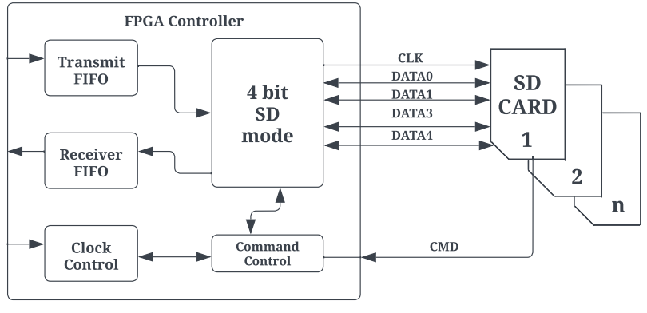
FPGA BLOCK DIAGRAM

Slide 9
WRITE BLOCK
A block on an SD card has been believed to be a sequence of 512 bytes of memory addresses for as long as anybody can remember.
The WRITE BLOCK command is used to permanently store data in a memory block beginning at address 2000.
16-bit CRC byte must be utilized for the final verification. The total number of bytes in the data packet will be 515, which is equivalent to 1 plus 512 plus 2.
The least significant bit (LSB) is set to 1 in this informative token (0xFE).
When the SD card is being used for something else, the output data will be reduced (if this option is set), but when it is no longer in use, the output data will be increased to indicate that it is accessible.

Slide 10
READ BLOCK
A single block of data (512 bytes) is read from the SD card in READ BLOCK mode.
Each SD card block is represented by a 512-byte memory address sequence.
The READ SINGLE BLOCK command is used to get a single block of data beginning at the given memory address. In this instance, 2000 is the beginning address.
The response from R1 should reach FPGA immediately following the instruction. All bits should be set to zero.
The FPGA may get information from the SD card if the R1 response byte is zero.
Each READ SINGLE BLOCK request from an SD card returns 512 bytes in response

Slide 11
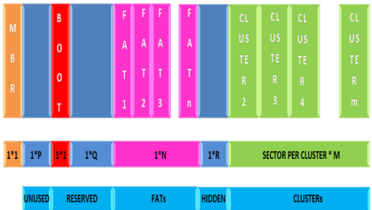
MASTER BOOT RECORD(MBR)
Master Boot Record(MBR ) comes after a lengthy time in which many sectors remained inactive.
These sectors are designated as reserved the BOOT sector comes first, followed by the FAT sector. The count of FAT sectors is determined by the file system size. Clusters followed FAT sectors.

Slide 12
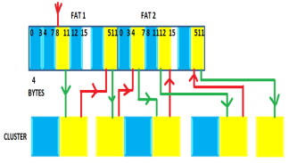
READING FILE FROM FAT32
FAT32 sector cluster counts are expressed by 32 bits.
Every cluster is represented by a 32-bit set.
If each cluster consists of 512 bytes, then the sector will have 128 cluster pointers. This section describes how space is allotted to files in a FAT32 file system.
The following equation may be used to compute the number of the next cluster pointer within the FAT32.
Number of sectors of FAT in the next cluster pointer = number of first sectors in partition + reserved number of sectors + ((clusters of current number * 4)/bytes per sector).
The yellow-colored box indicates the cluster that contain the data for each file in FAT32 and the respective cluster pointers. The red-colored line shows that the next cluster pointer which matches the present cluster is being sought, while the green-colored line shows that the next cluster is being sought using the cluster thing about having in the FAT32 clusters pointer.

Slide 13
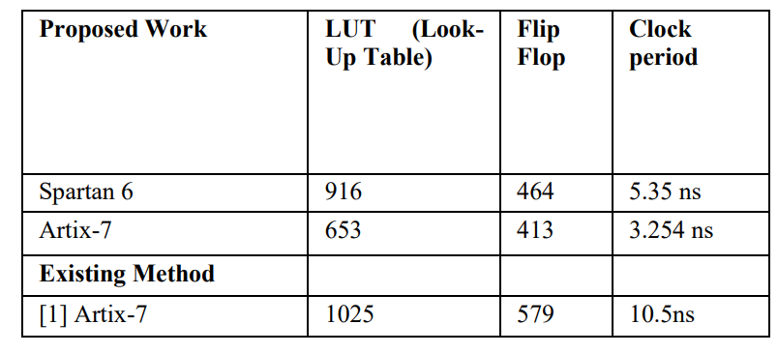
RESULT
Comparing the specifications of the Spartan 6 FPGA (530 Slice Registers, 916 LUT's, 464 Flip Flops, 5.35 ns clock period, 186.925 MHz frequency) and the Artix-7 (512 Slice Registers, 653, LUT's, 413 Flip Flops, 3.254 ns clock period, 307.342 MHz frequency) demonstrates that our proposed results provide better resource utilization than existing methods.

Slide 14
CONCLUSION
This research proposes an FPGA controller for SD card reading/writing in 4-bit SD mode.
It is allowed to address individual cards out of sequence, notwithstanding the architecture's suggestion.
There is a large quantity of storage capacity available.
Easily expandable storage system add number SD cards contain sharing the same clock and data signals different chip select signal for each card was suggested the architecture involves accessing each card in sequence, but it is allowed. Availability of large amounts of memory.

Slide 15
REFERENCE PAPERS
[1] D. C. Costache, L. A. Perişoară and A. Florescu, "FPGA Implementation of a SD Card Controller using SPI communication," 2020 12th International Conference on Electronics, Computers and Artificial Intelligence (ECAI), 2020, pp. 1-4.
[2] Zhenlin LU, Jingjiao LI, Yao Zhang. 2010. The Reading/Writing SD Card System Based on FPGA. 2010 First International Conference on Pervasive Computing Signal Processing and Applications (PCSPA), pp. 419-422.
[3] O. Elkeelany and V. S. Todakar, "Data Archival to SD Card Via Hardware Description Language," in IEEE Embedded Systems Letters, vol. 3, no. 4, pp. 105-108, Dec. 2011.
[4] Gul Munir Ujjan, Abdul Malik, Mohd Zaid Abdullah, Shakil Ahmed, “Implementation of 4-bit data transmission for accessing SD card with FPGA Embedded Soft Processor;” ICIIT '19, February 20–23, 2019, DaNang, Viet Nam.
[5] Jiayi Qiang, Yong Gu and Guochu Chen, “FPGA Implementation of SPI Bus Communication Based on State Machine Method,” Journal of Physics: Conference Series 1449 012027, 2020.
[6] Pallavi Polsani, V. Priyanka.B, Y. Padma Sai, “Design & Verification of Serial Peripheral Interface (SPI) Protocol,” IJRTE, Volume-8 Issue- 6, March 2020.
[7] Fareha Naqvi, “Design and Implementation of Serial Peripheral Interface Protocol Using Verilog HDL,” International Journal of Engineering Development and Research 2015.
[8] N Nandhagopal, S Navaneethan, V Nivedita, A Parimala, D Valluru “Human Eye Pupil Detection System for Different IRIS Database Images” Journal of Computational and Theoretical Nanoscience volume 18, issue no 4, page no 1239-1242, 2021.
[9] Manish Kumar Birla. 2006. FPGA Based Reconfigurable Platform for Complex Image Processing. IEEE, 6th International Conference on EIT, pp.204-209.
[10] V. Asanza, A. Constantine, S. Valarezo and E. Peláez, "Implementation of a Classification System of EEG Signals Based on FPGA," 2020 Seventh International Conference on eDemocracy & eGovernment (ICEDEG), 2020, pp. 87-92.
[11] S Navaneethan, N Nandhagopal, V Nivedita “An FPGA-based real- time human eye pupil detection system using E2V smart camera”, Journal of Computational and Theoretical Nanoscience 16 (2), 649-654 2019.
[12] Yansi Yang, Yingyun Yang, Lipi Niu, Huabing Wang and Bo Liu, "Hardware system design of SD card reader and image processor on FPGA," 2011 IEEE International Conference on Information and Automation, 2011, pp. 577-580.
[13] M. K. Birla, "FPGA Based Reconfigurable Platform for Complex Image Processing," 2006 IEEE International Conference on Electro/Information Technology, 2006, pp. 204-209

Slide 16
THANK YOU

